Slide 1


Basic Data Analysis and Visualization
Asst. Prof. Dr. Watshara Shoombuatong
Center of Data Mining and Biomedical Informatics
watshara.sho@mahidol.ac.th

Slide 2
How to Choose the Best Charts
for Your Data?

Slide 3
Step 1: Determine your visualization goal

Slide 4
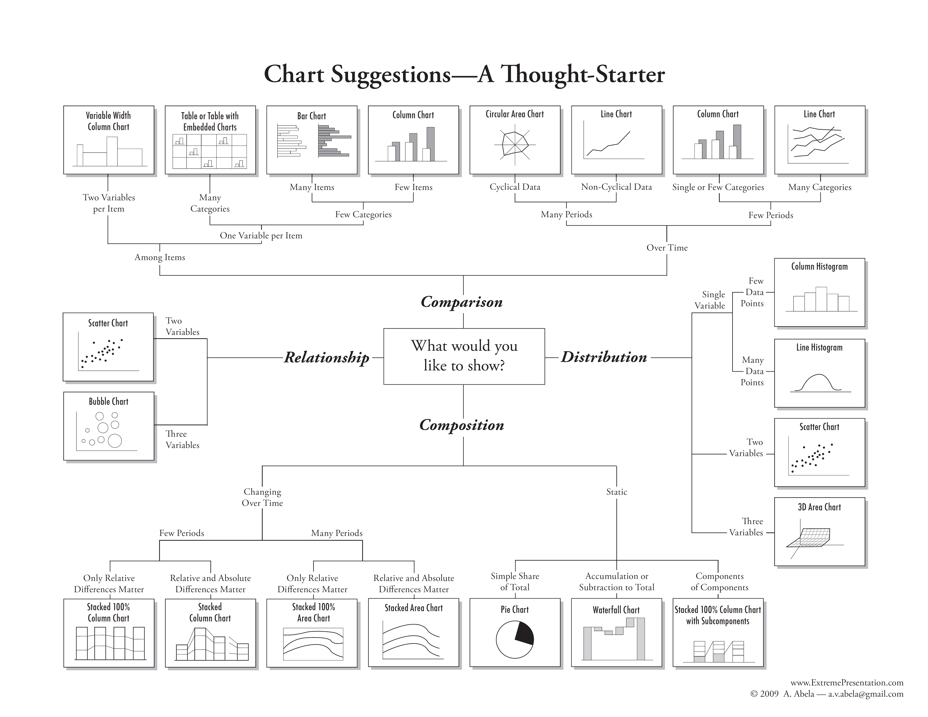

Slide 6
Basic presentation types
There are four basic presentation types that you can use to present your data:
Comparison
Composition
Distribution
Relationship
Unless you are a statistician or a data-analyst, you are most likely using only the two, most commonly used types of data analysis: Comparison or Composition.

Slide 7
Do you want to compare values?
A comparison tries to set one set of variables apart from another, and display how those two variables interact, like the number of visitors to five competing web sites in a single month.
Column
Bar
Line

Slide 8
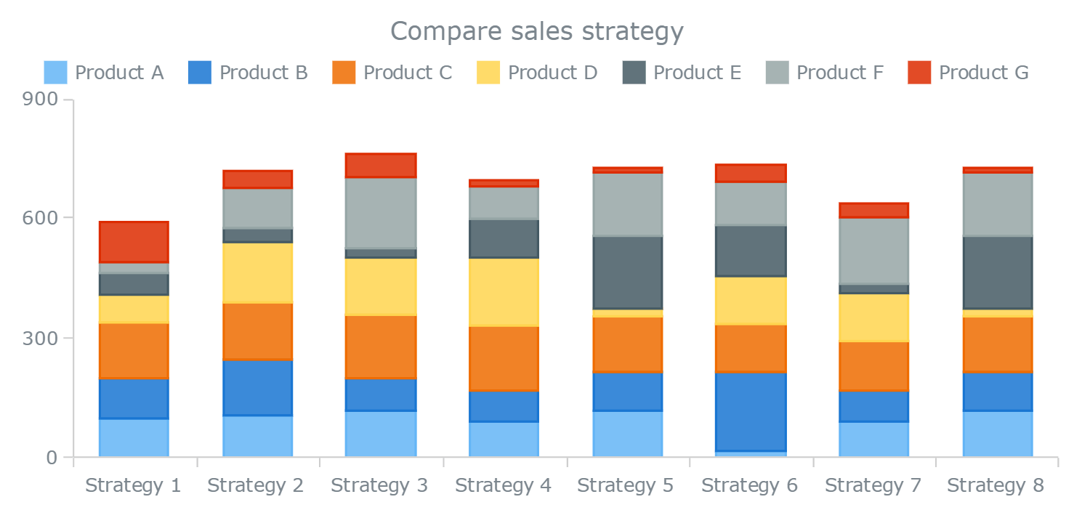
Do you want to show the composition of something?
A composition tries to collect different types of information that make up a whole and display them together, like the search terms that those visitors used to land on your site, or how many of them came from links, search engines, or direct traffic.
Pie
Stacked Bar or Column
Stacked Area

Slide 9
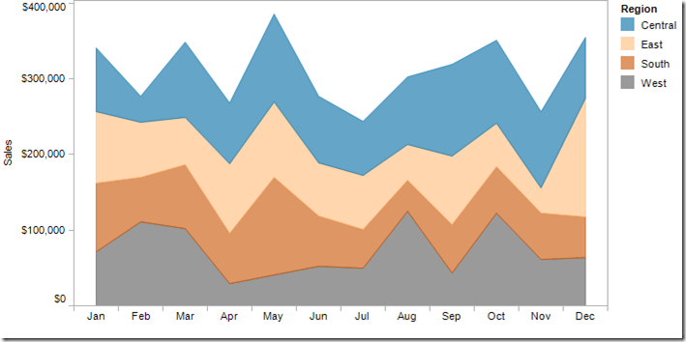
Do you want to show the composition of something?
A composition tries to collect different types of information that make up a whole and display them together, like the search terms that those visitors used to land on your site, or how many of them came from links, search engines, or direct traffic.
Pie
Stacked Bar or Column
Stacked Area

Slide 10
Do you want to understand the distribution of your data?
A distribution tries to lay out a collection of related or unrelated information simple to see how it correlates.
Scatter Plot
Line
Column
Bar

Slide 11
Do you want to better understand the relationship between value sets?
A relationship tries to show a connection or correlation between two or more variables through the data presented, like the market cap of a given stock over time versus overall market trend.
Scatter Plot
Bubble
Line

Slide 12
Selecting the right chart
To determine which chart is best suited for each of those presentation types, first you must answer a few questions:
How many categories do you want to show in a single chart? One, two, three, many?
How many items (data points) will you display for each variable? Only a few or many?
Will you display values over a period of time, or among items or groups?

Slide 13
Tables
Tables are essentially the source for all the charts. They are best used for comparison, composition, or relationship analysis when there are only few variables and data points.
It would not make much sense to create a chart if the data can be easily interpreted from the table.

Slide 14
Tables
Use tables when:
You need to compare or look up individual values.
You require precise values.
Values involve multiple units of measure.
The data has to communicate quantitative information, but not trends.
Use charts when the data presentation:
Is used to convey a message that is contained in the shape of the data.
Is used to show a relationship between many values.

Slide 15
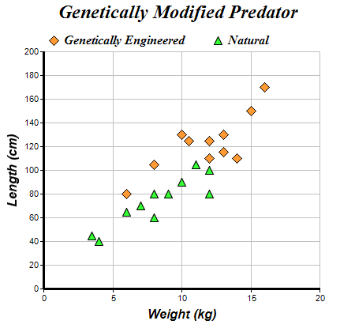
Scatter chart
A scatter chart works best when comparing large numbers of data points without regard to time.
This is a very powerful type of chart and good when your are trying to show the relationship between two variables (x and y axis), for example a person's weight and height.

Slide 16
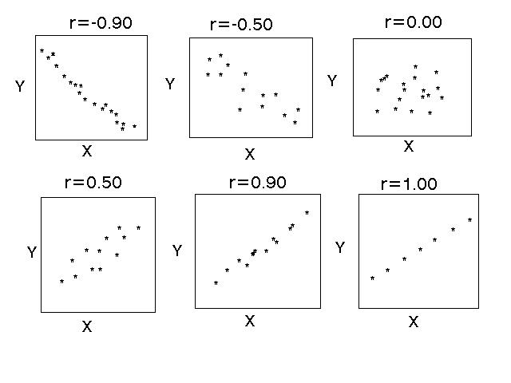
Scatter chart
These plots are often the ﬁrst step in the statistical analysis of the correlation between variables and subsequent regression analysis.

Slide 17
Bubble chart
Bubble charts are a special kind of XY chart that can display another data series which is used to scale the bubble (marker) plotted at X and Y values.
You can think of a bubble chart as "X versus Y, scaled by Z". Like a regular XY scatter chart, both axes are used to plot values

Slide 18
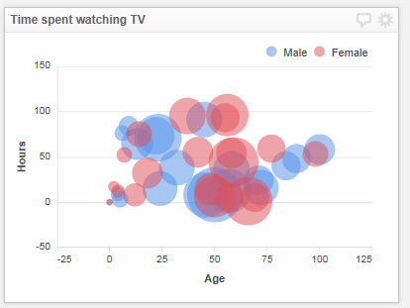
Bubble chart

Slide 19
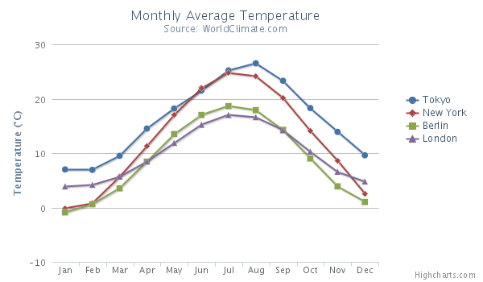
Line chart
The line chart is represented by a series of data points connected with a straight line.
Line charts are most often used to visualize data that changes over time.
https://www.highcharts.com/docs/chart-and-series-types/line-chart

Slide 20
Histograms and Bar charts
Bar charts and histograms can both be used to compare the sizes of different groups.
A Bar chart is made up of bars plotted on a graph.
Histogram is a chart representing a frequency distribution; heights of the bars represent observed frequencies.

Slide 21
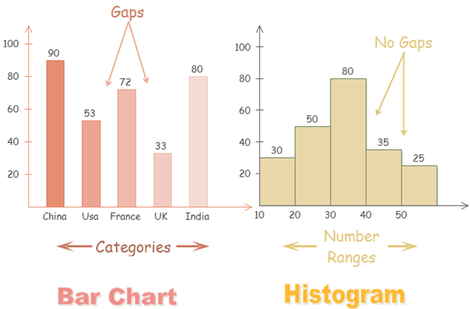
Difference between Histograms and Bar charts
Bar Chart
The columns are positioned over a label that represents a categorical variable.
The height of the column indicates the size of the group defined by the categories.
Histogram
The columns are positioned over a label that represents a quantitative variable.
The column label can be a single value or a range of values.
https://www.edrawsoft.com/histogram-vs-bar-chart.php

Slide 22
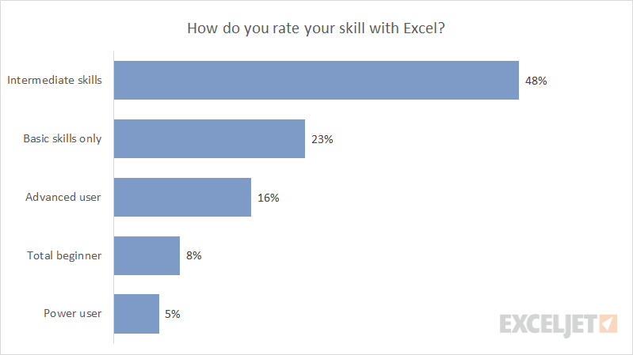
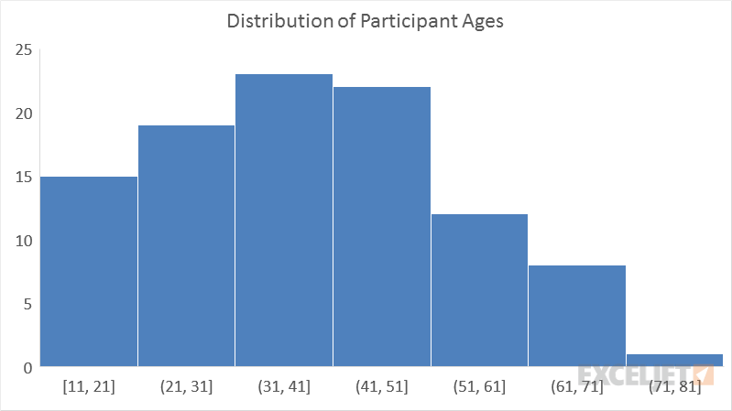
Difference between Histograms and Bar charts

Slide 23
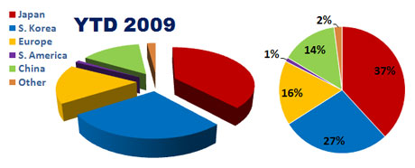
2D- vs 3D- charts
Highcharts 3D is a Highcharts module providing limited 3D support to charts.
It currently allows to create 3D Column charts, 3D Pie charts and 3D Scatter charts.
http://www.powerpointninja.com/charts/curse-of-pac-man-the-danger-of-3d-charts-in-powerpoint/

Slide 24
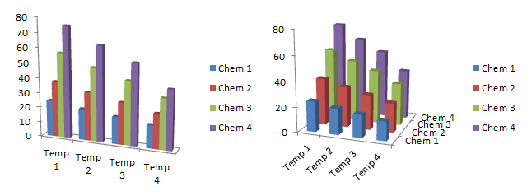
2D- vs 3D- charts
https://peltiertech.com/excel-3d-charts-charts-with-no-value/

Slide 25
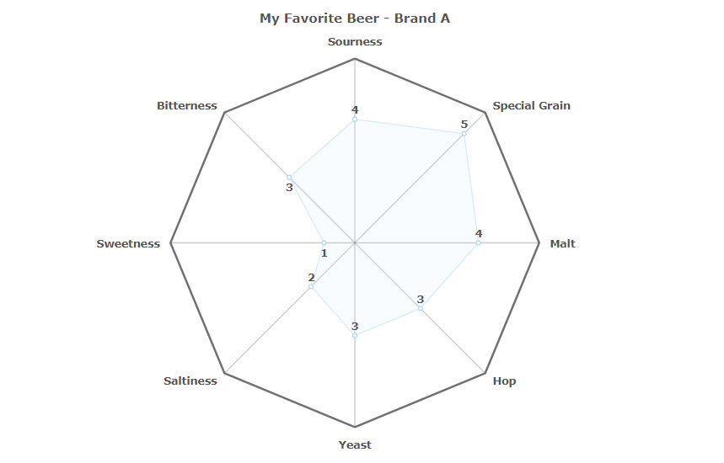
Radar or Circular area chart
A Radar Chart is a graphical method of displaying multivariate data in the form of a two-dimensional chart of three or more quantitative variables represented on axes starting from the same point.
https://www.fusioncharts.com/chart-primers/radar-chart/

Slide 26
Radar or Circular area chart
Suppose you were asked to rank your favorite beer on 8 aspects (Sourness, Bitterness, Sweetness, Saltiness, Yeast, Hop, Malt and Special Grain) and then show them graphically, you might use a Column Chart for it.
But when there are a large number of variables (8 in this case), the column chart might look cluttered. In such scenarios, try the radar chart instead!

Slide 27
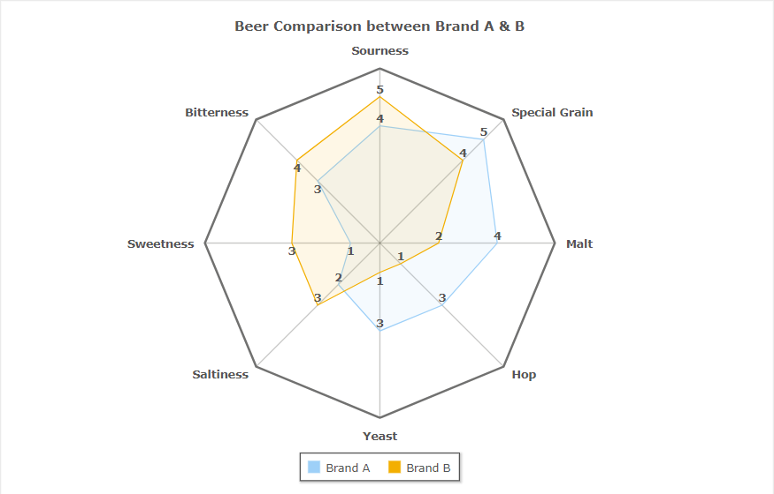
Radar or Circular area chart
The 2 beers are ranked on each of the 8 parameters.
The color coding for each beer helps to visually correlate and contrast the beers over its diverse aspects.
If you like your beer bitter, the chart gives you an indication that maybe it's time you switched to Beer B (as Beer B has a higher rank in bitterness to Beer A).
https://www.fusioncharts.com/chart-primers/radar-chart/

Slide 28
Box & Whisker chart
The Box & Whisker chart displays the spread and skewness in a batch of data through its five-number summary: minimum, maximum, median, upper and lower quartiles. It is used:
For a quick understanding of the distribution of a dataset
To know whether a distribution is skewed or not
To find out unusual observations/errors in the data set

Slide 29
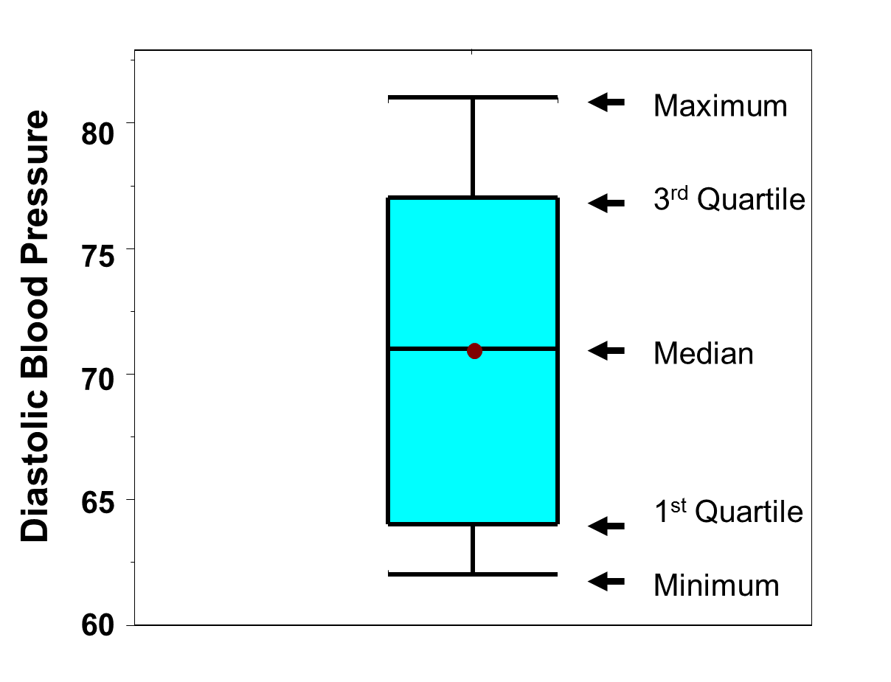
Box & Whisker chart
Five-number summary: minimum, maximum, median, upper and lower quartiles
http://sphweb.bumc.bu.edu/otlt/MPH-Modules/BS/BS704_SummarizingData/BS704_SummarizingData8.html

Slide 30
Example: A drug company tested three formulations of a pain relief medicine for migraine headache sufferers. For the experiment 27 volunteers were selected and 9 were randomly assigned to one of three drug formulations. The subjects were instructed to take the drug during their next migraine headache episode and to report their pain on a scale of 1 to 10 (10 being most pain).
Drug A: 4 5 4 3 2 4 3 4 4
Drug B: 6 8 4 5 4 6 5 8 6
Drug C: 6 7 6 6 7 5 6 5 5

Slide 31
Example: A clinical trial is run to compare weight loss programs and participants are randomly assigned to one of the comparison programs and are counseled on the details of the assigned program. Participants follow the assigned program for 8 weeks. The outcome of interest is weight loss, defined as the difference in weight measured at the start of the study (baseline) and weight measured at the end of the study (8 weeks), measured in pounds.
Three popular weight loss programs are considered. The first is a low calorie diet. The second is a low fat diet and the third is a low carbohydrate diet. For comparison purposes, a fourth group is considered as a control group. Participants in the fourth group are told that they are participating in a study of healthy behaviors with weight loss only one component of interest. The control group is included here to assess the placebo effect (i.e., weight loss due to simply participating in the study). A total of twenty patients agree to participate in the study and are randomly assigned to one of the four diet groups. Weights are measured at baseline and patients are counseled on the proper implementation of the assigned diet (with the exception of the control group). After 8 weeks, each patient's weight is again measured and the difference in weights is computed by subtracting the 8 week weight from the baseline weight. Positive differences indicate weight losses and negative differences indicate weight gains. For interpretation purposes, we refer to the differences in weights as weight losses and the observed weight losses are shown below.
Low Calorie | Low Fat | Low Carbohydrate | Control
8 | 2 | 3 | 2
9 | 4 | 5 | 2
6 | 3 | 4 | -1
7 | 5 | 2 | 0
3 | 1 | 3 | 3

Slide 32
Example: Consider the clinical trial outlined above in which three competing treatments for joint pain are compared in terms of their mean time to pain relief in patients with osteoarthritis. Because investigators hypothesize that there may be a difference in time to pain relief in men versus women, they randomly assign 15 participating men to one of the three competing treatments and randomly assign 15 participating women to one of the three competing treatments (i.e., stratified randomization). Participating men and women do not know to which treatment they are assigned. They are instructed to take the assigned medication when they experience joint pain and to record the time, in minutes, until the pain subsides. The data (times to pain relief) are shown below and are organized by the assigned treatment and sex of the participant.
Treatment | Male | Female
A | 12 | 21
 | 15 | 19
 | 16 | 18
 | 17 | 24
 | 14 | 25
B | 14 | 21
 | 17 | 20
 | 19 | 23
 | 20 | 27
 | 17 | 25
C | 25 | 37
 | 27 | 34
 | 29 | 36
 | 24 | 26
 | 22 | 29
Table of Time to Pain Relief by Treatment and Sex

